Slide 1




BOT Work Shop
Eric Hullander
January 26th, 2017
Bellevue, WA

Slide 2
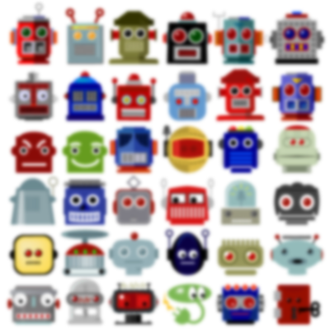

Tools You Will Need
https://docs.botframework.com/en-us/
Required:
Microsoft Account
Visual Studio 2015 or higher
Microsoft.Bot.Builder ("Manage NuGet Packages“ in VS)
Bot emulator
Web Browser
Skype, etc.
Optional:
SQL Management Studio
Excel
Notepad
PowerBI

Slide 3
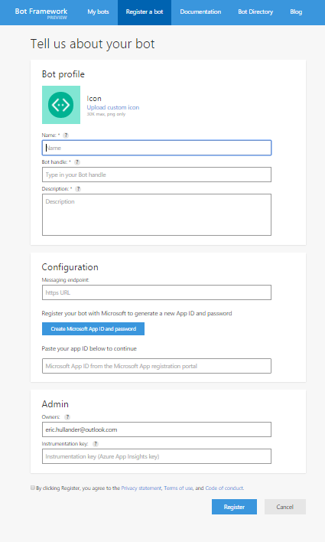
Bot Framework
Sign into Azure
https://dev.botframework.com/
Click Register a Bot
Fill in
Name
Bot Handle
Click Create Microsoft App ID and password
Will leave “Messaging Endpoint” Blank

Slide 4
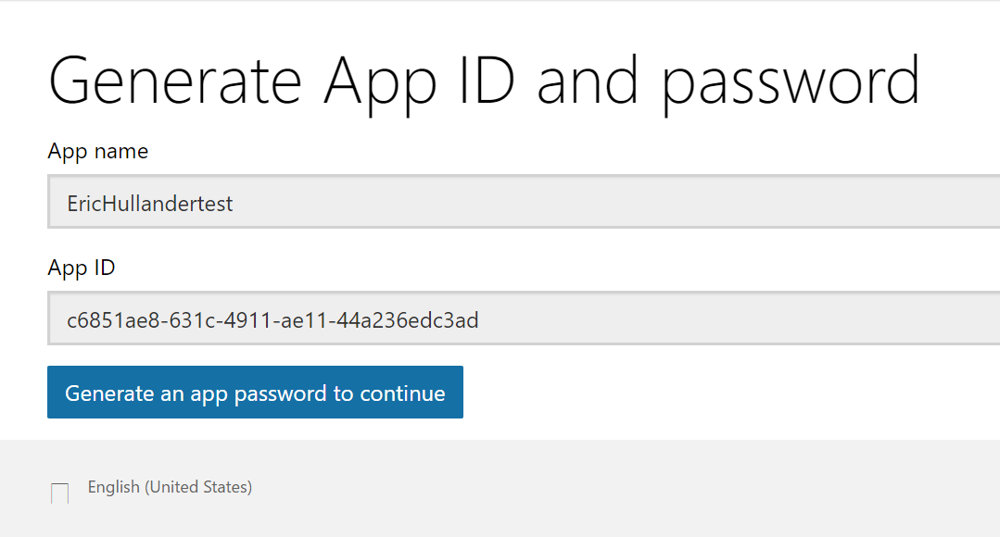
Bot Framework
Copy the App ID to notepad for future use

Slide 5
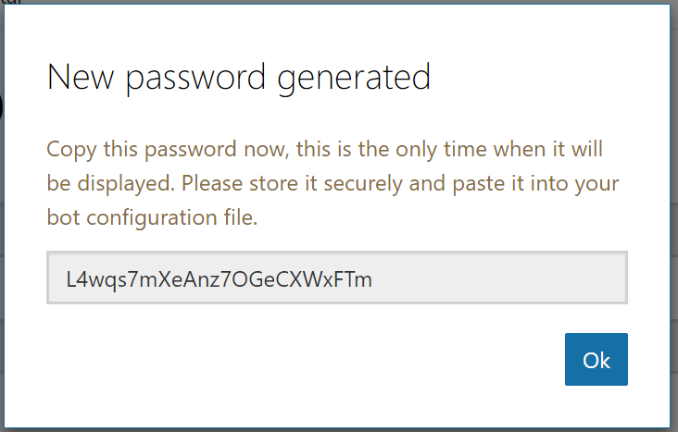
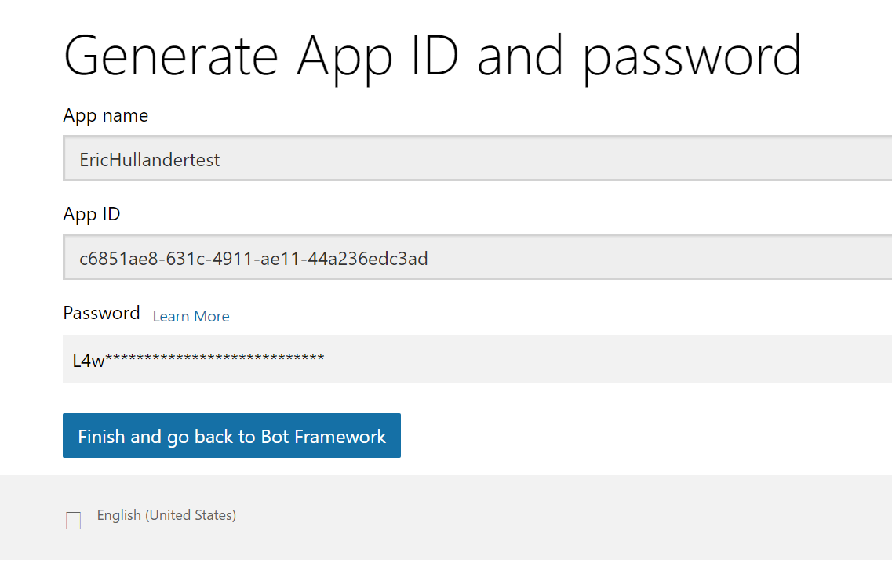
Bot Framework
AppID and Password
Copy the App ID to notepad for future use
Click “Generate an app password…”
Copy the Password to notepad for future use
Click “OK”
“Click Finish and go to Bot Framework”
App name: EricHullandertest
App ID: c6851ae8-631c-4911-ae11-44a236edc3ad
App pw: L4wqs7mXeAnz7OGeCXWxFTm

Slide 6
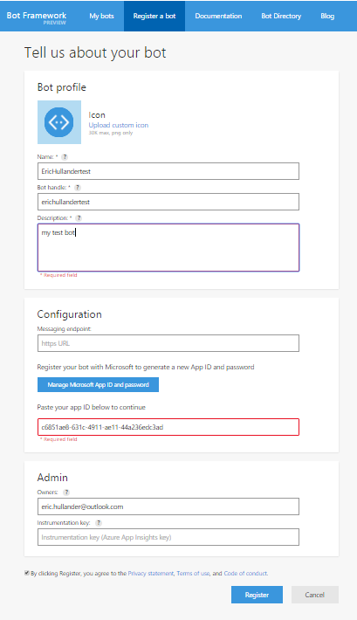
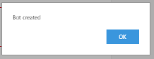
Bot Framework
Registration
Add the description if you haven’t
Leave endpoint blank for now
Click if you agree to the T&Cs
Click “Register”
Click “OK” on “Bot created” menu
You have just taken your first step into a much larger world…
Option: You may add an app icon now or later if you like…

Slide 7
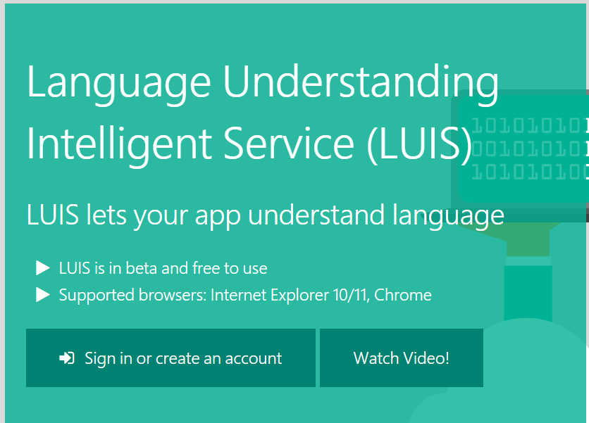
LUIS
Sign into Azure
https://www.luis.ai/
Sign in with your Microsoft account

Slide 8
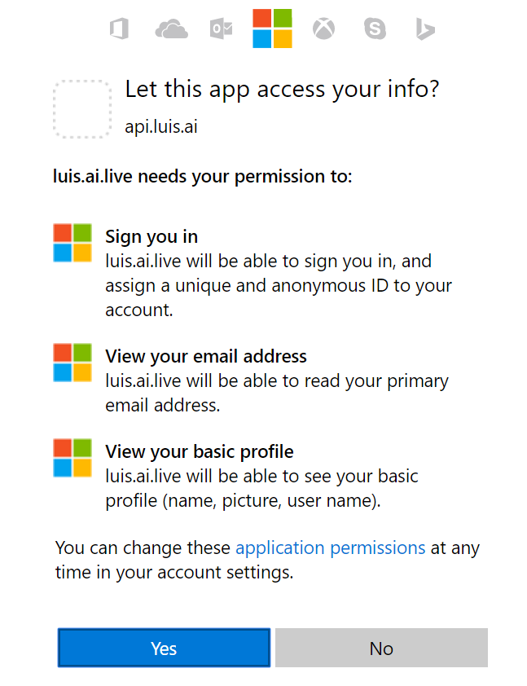
LUIS
Sign into Azure
https://www.luis.ai/
Sign in with your Microsoft account
“Yes”

Slide 9
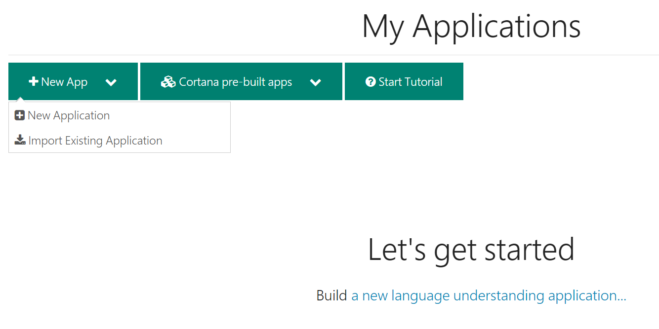
LUIS
Building a LUIS Model
New App
Choose “Import…”
A LUIS Application (model) takes examples of many phrases (utterances) that mean the same thing and maps them to a single intent.
A LUIS Application can have up to 40 unique intents
Given a new utterance, LUIS predicts which of the 40 intents is the best mach

Slide 10
LUIS
Building a LUIS Model
New App
Choose “Import…”
Further, entities (nouns, verbs, adjectives) can be inferred from within an utterance
Example:
I want to buy a house.
I want to buy a car.
Might map to the intent “purchase”
The entity could be “house” or “car”

Slide 11
LUIS
Building a LUIS Model
New App
Choose “Import…”
To work best, LUIS needs many examples to learn from
Fortunately, if you’ve already trained LUIS before, and you’re application will be using the same set of intents and entities you can recycle an existing model and build on it

Slide 12
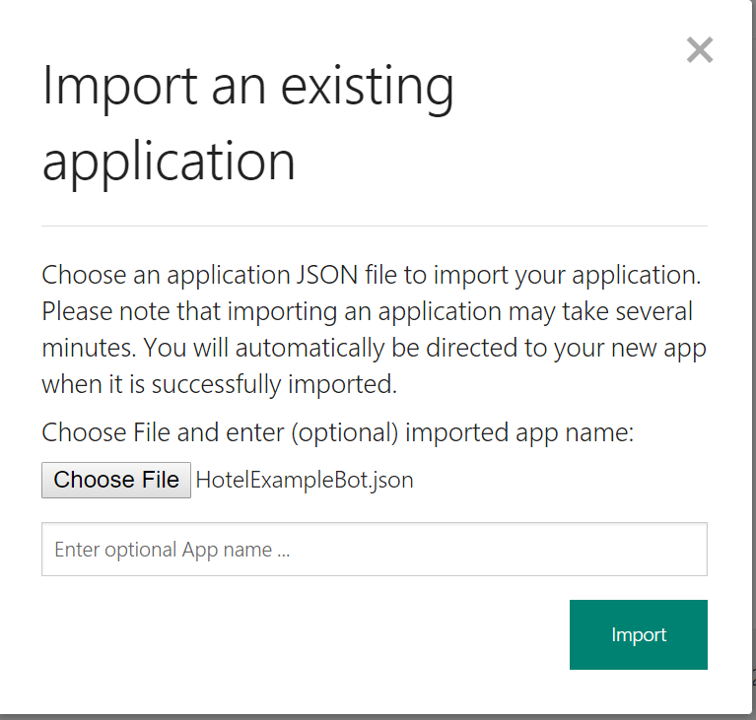
LUIS
Building a LUIS Model
Once a model has been trained, we can export it as a JSON file
Click “Choose File” and Navigate to the JSON file provided
Click “Import”

Slide 13
LUIS
JSON File
{
"luis_schema_version": "1.3.0",
"name": "HotelExampleBot",
"desc": "",
"culture": "en-us",
"intents": [
{
"name": "Buy"
},
{
"name": "BuyHikingBoots"
},
{
"name": "EndIntent"
},
{
"name": "FindHikes"
},
{
"name": "ForgotTrailPass"
{
"text": "camp sites",
"intent": "SearchCamping",
"entities": []
},
{
"text": "camping",
"intent": "SearchCamping",
"entities": []
},
{
"text": "any hikes",
"intent": "FindHikes",
"entities": []
},
{
"text": "do they have nice hikes?",
"intent": "FindHikes",
Within the JSON file you will find lists of intents and later, text and entities that map to that intent
You may edit this JSON directly and upload it, or use the interface

Slide 14
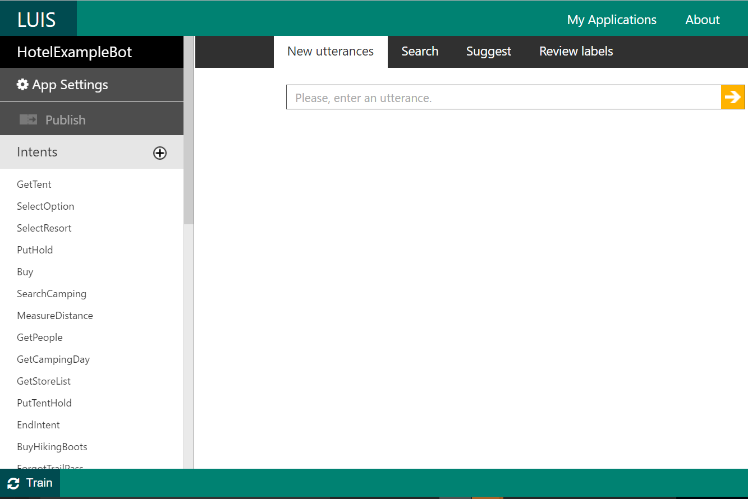
LUIS
Editing
Once Loaded we see this screen
The list on the left are the “intents” this model understands
If we click (+), we can add new intents to the model
Even though we have imported the file, we still need to train the algorithm to recognize utterances
Click “Train”

Slide 15
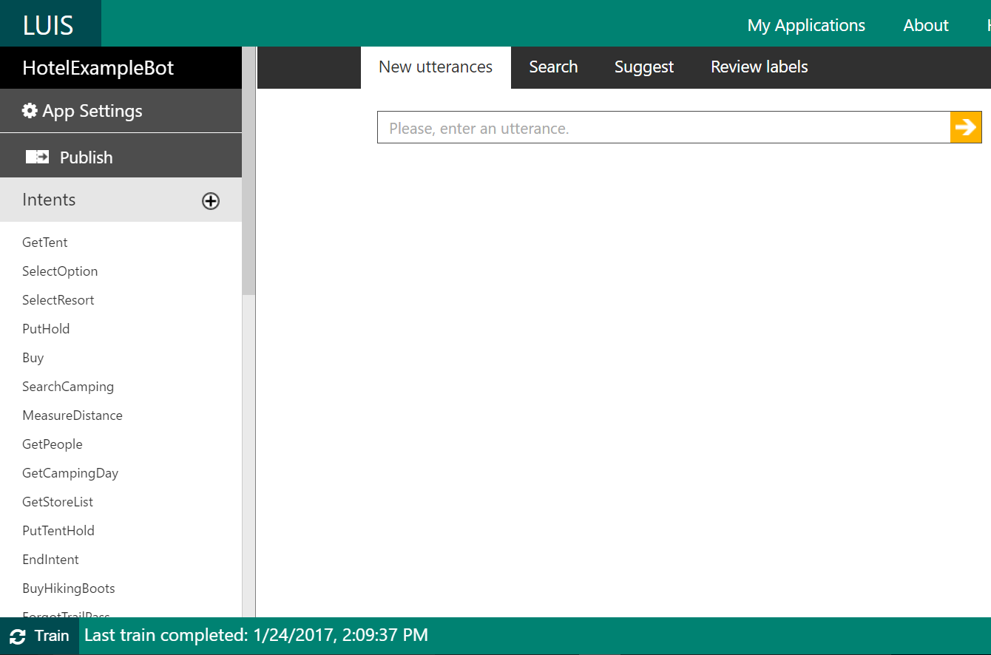
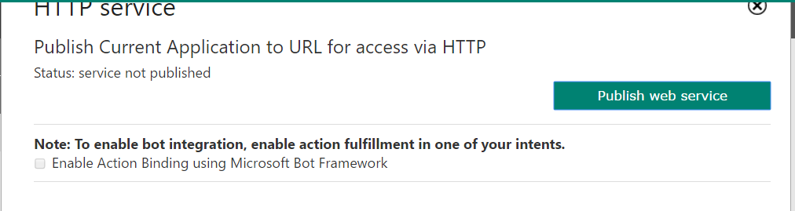
LUIS
Publishing
Training can take some time. Click “Publish
Click “Publish web Service”

Slide 16
LUIS
Publishing
Training can take some time. Click “Publish
Click “Publish web Service”

Slide 17
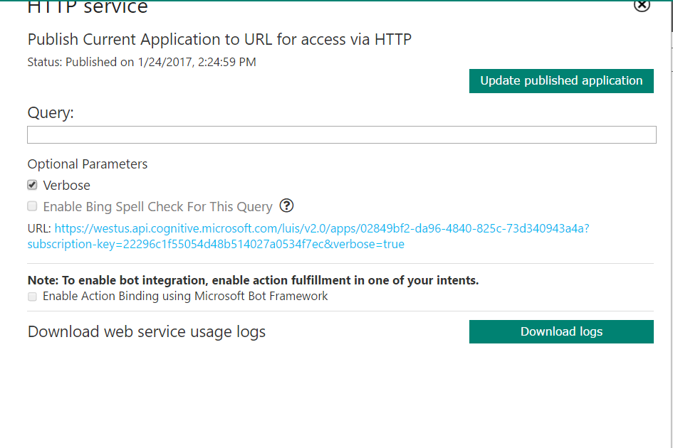
LUIS
Testing
You can type an utterance into “Query” to see how the model scores it. Given an utterance it will give each possible intent in the model a score
Example
Query: “find a trail”
{ "query": "find a trail", "topScoringIntent": { "intent": "GetTrailPass", "score": 0.9974881 }, "intents": [ { "intent": "GetTrailPass", "score": 0.9974881 },
{ "intent": "None", "score": 0.5163145 },
{ "intent": "ForgotTrailPass", "score": 0.0379541256 },
{ "intent": "Buy", "score": 0.0100398948 },
{ "intent": "PutTentHold", "score": 0.007901444 },
{ "intent": "Help", "score": 0.00303268922 },
{ "intent": "SelectResort", "score": 0.00238058716 },

Slide 18
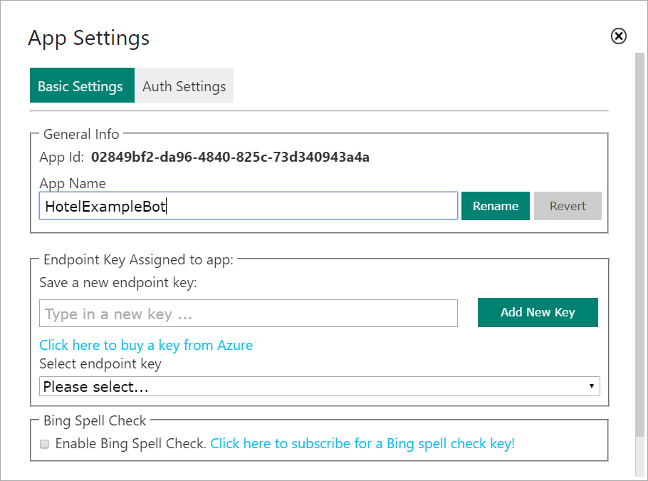
LUIS
AppID and Key
Click App Settings
Copy the App Id to your notepad
In the top banner, click on your account name

Slide 19
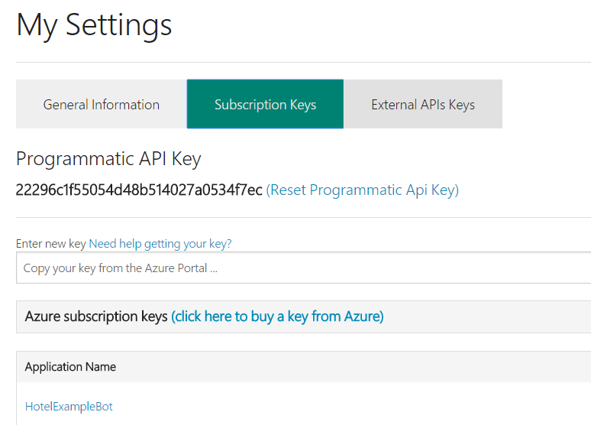
LUIS
AppID and Key
In the top banner, click on your account name
Click Subscription Keys
Copy the API Key to your notepad
App name: EricHullandertest
App ID: c6851ae8-631c-4911-ae11-44a236edc3ad
App pw: L4wqs7mXeAnz7OGeCXWxFTm
LUIS App Name: HotelExampleBot
LUID ADD ID: 02849bf2-da96-4840-825c-73d340943a4a
LUID Key: 22296c1f55054d48b514027a0534f7ec

Slide 20
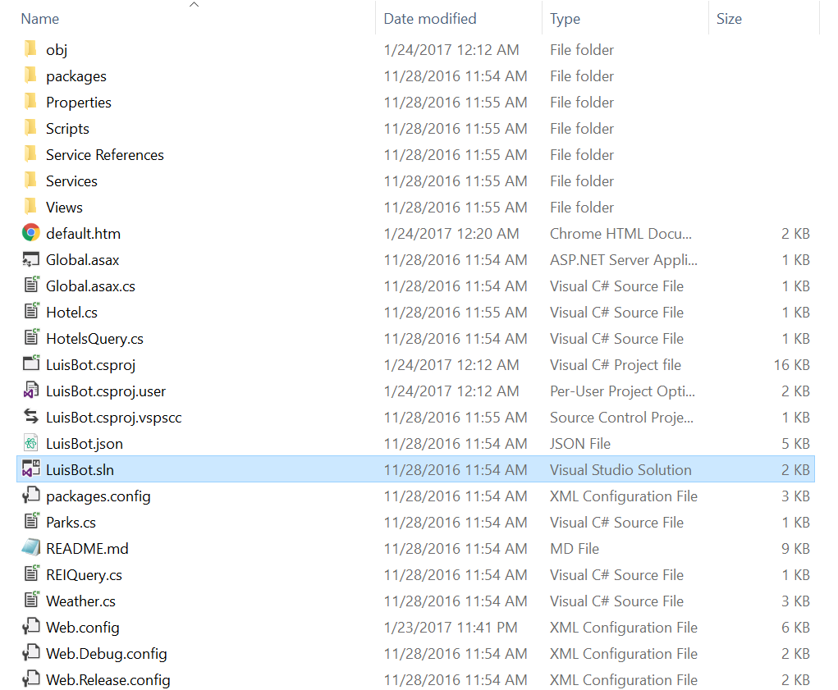
Visual Studio
Unzip and then navigate to the .sln file in the the zip file provided
Open in Visual Studio
This can be used as a template for future bot building and will provide a starting point for your exploration
Some configuration is required

Slide 21
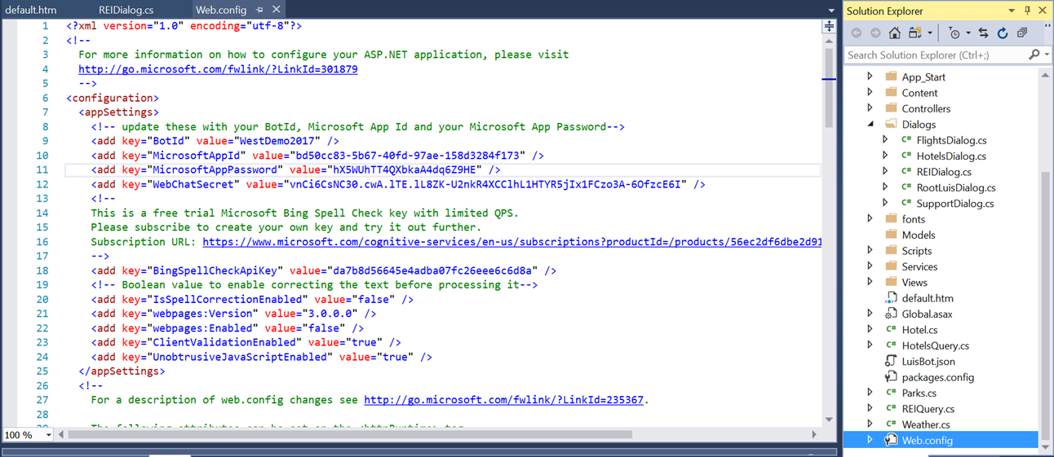
Visual Studio
Unzip and then navigate to the .sln file in the the zip file provided
Open in Visual Studio
Open Web.config
Fill in from your notepad
BotId
MicrosoftAppId
MicrosoftAppPassword

Slide 22
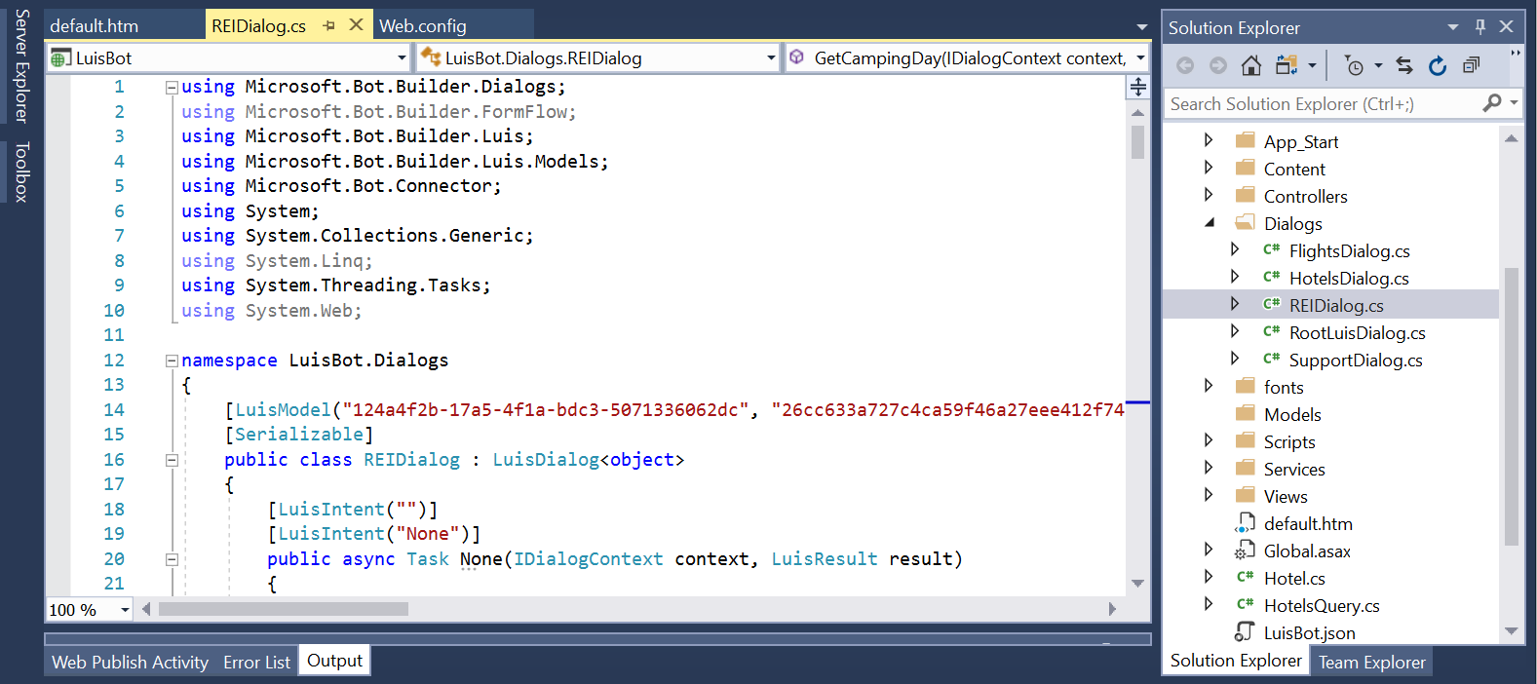
Visual Studio
Open REIDialog.cs
Enter the App ID and Password

Slide 23
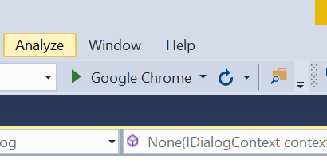
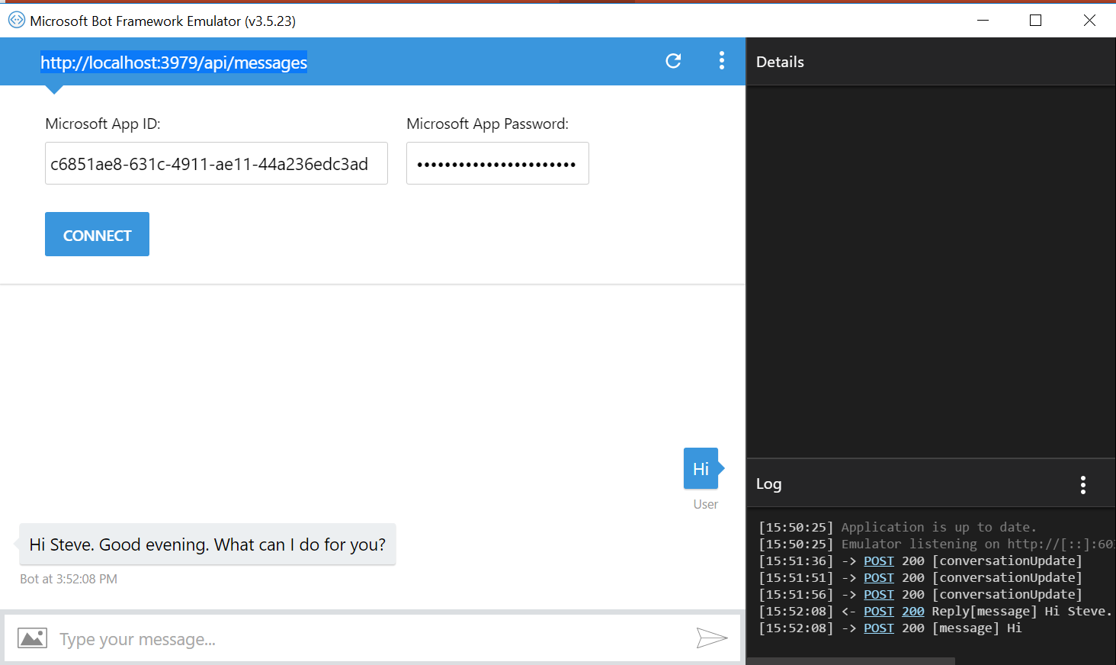
Bot Emulation
Before we publish we will test the bot locally using the bot emulator
Click the Play Button to have the bot run on your local host
Launch the Bot emulator
Input the address of your local host
Input your AppID and PW
Let the emulator connect
Say “Hi”

Slide 24
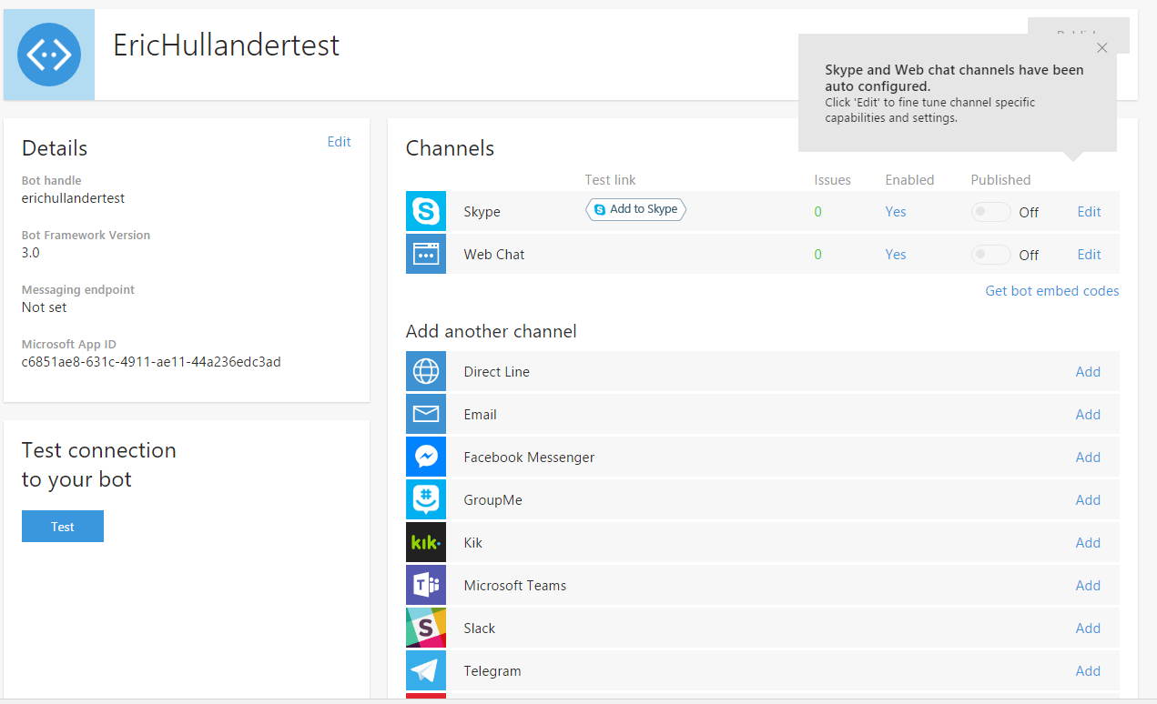
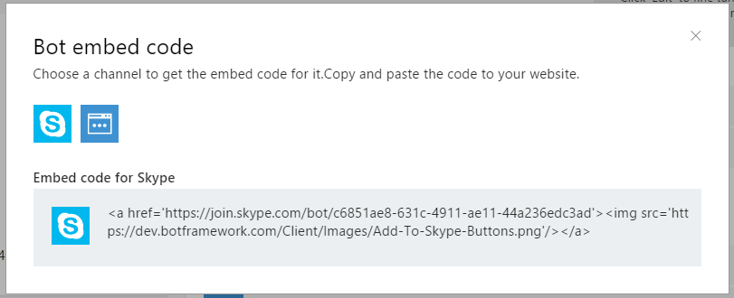
Bot Publication
Skype
Return to https://dev.botframework.com/bots?id=erichullandertest
Click the light blue Skype icon
Click “Get bot embed codes”
Copy the embed code to your notepad

Slide 25
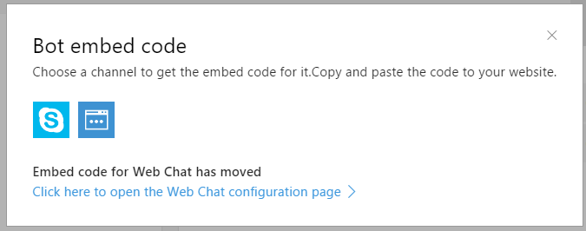
Bot Publication
Web
Click the dark blue web icon icon
“Click here to open the web…”

Slide 26
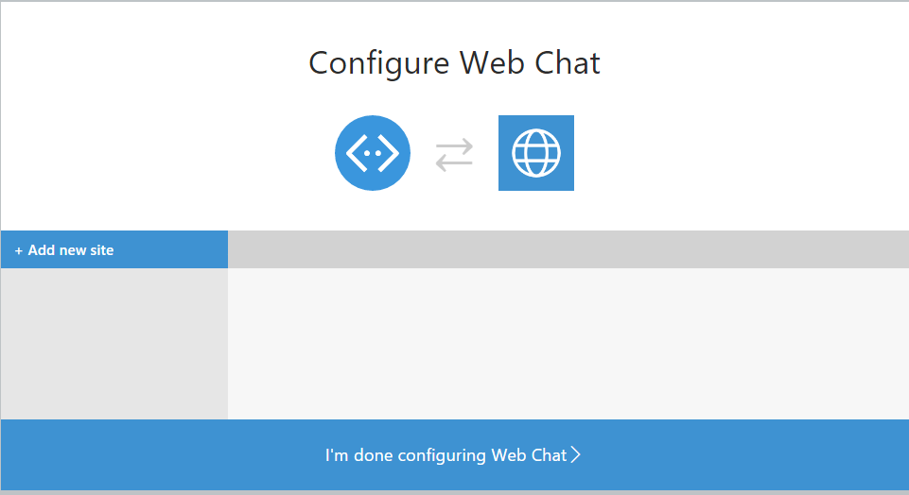
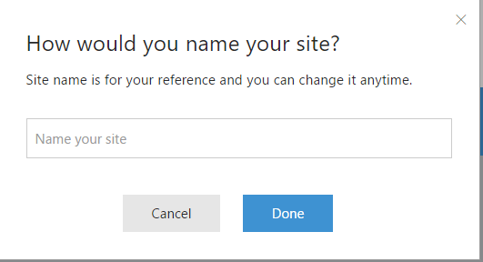
Bot Publication
Web
Click “Add New Site”
Give your site a name
“MySite”
Click Done

Slide 27
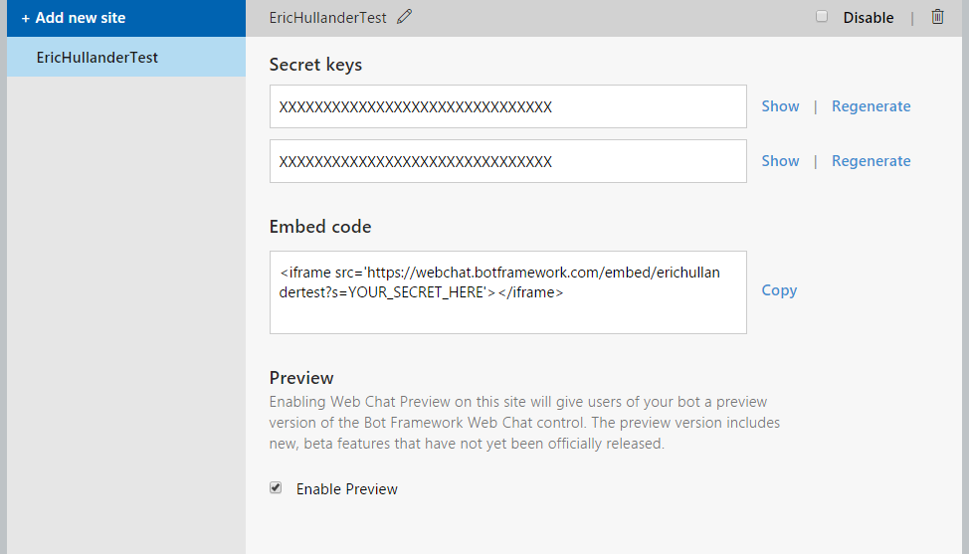
Bot Publication
Web
Show
Copy Secret to notepad
Copy Embed Code to notepad
Replace “YOUR_SECRET_HERE in embed code with your secret

Slide 28
Visual Studio
The web secret goes here too

Slide 29
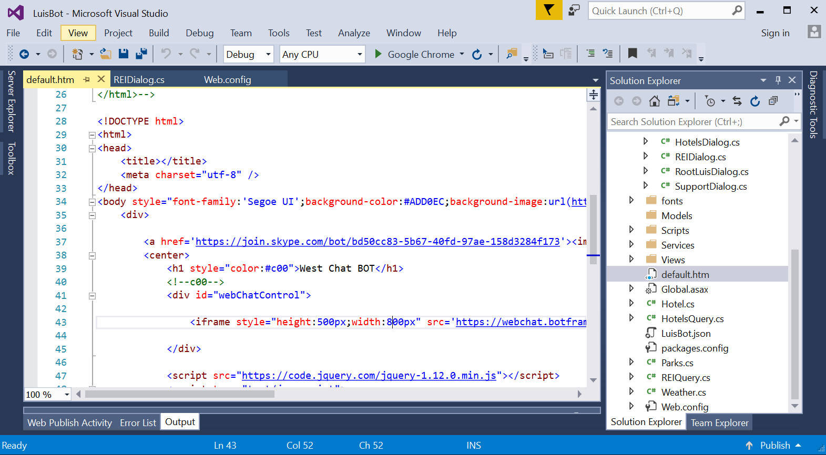
Bot Publication
Web
Navigate to default.htm in Visual Studio
Find the <a href> tag and replace with the <a href> tag for Skype in your notepad
Find the <iframe> tag and replace it with the iframe tag in your notepad
This will enable Skype and the web interface for your bot

Slide 30
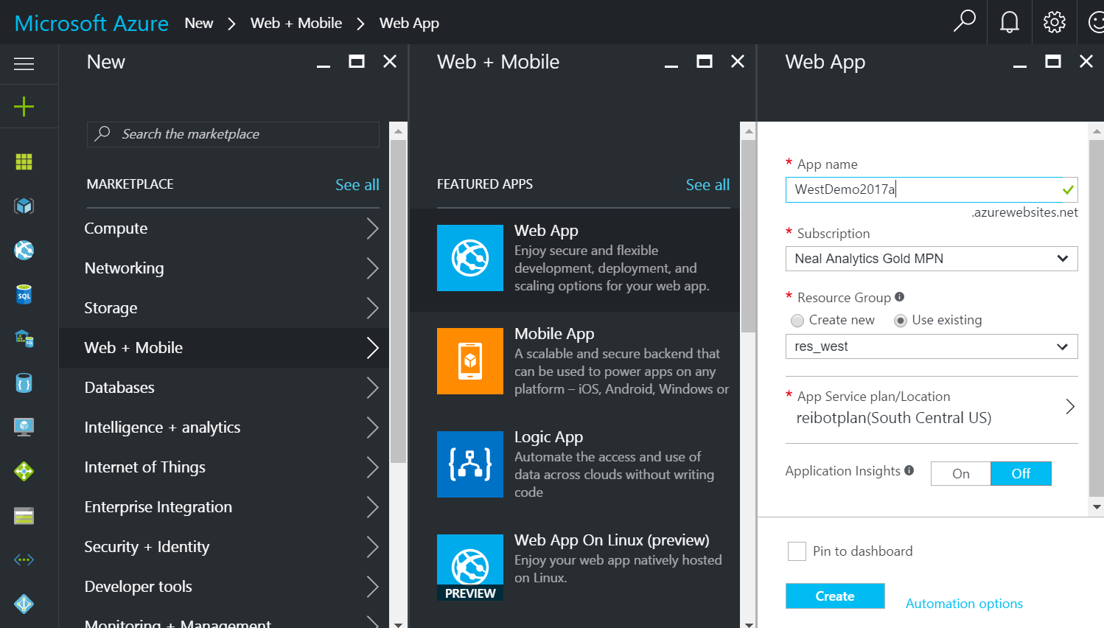
Bot Publication
Azure Portal
https://portal.azure.com/
Click +
Click “Web + Mobile”
Web App

Slide 31
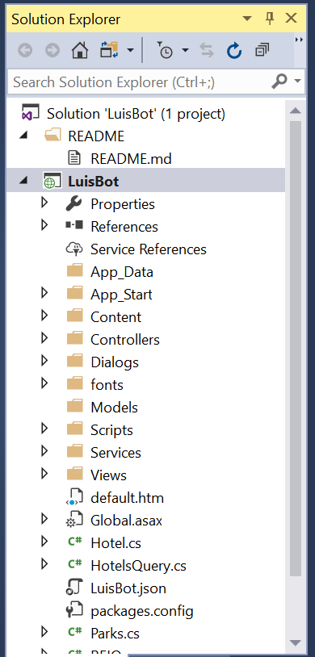
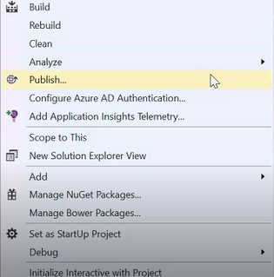
Bot Publication
Web
Right Click on your solution
Click “Publish”

Slide 32
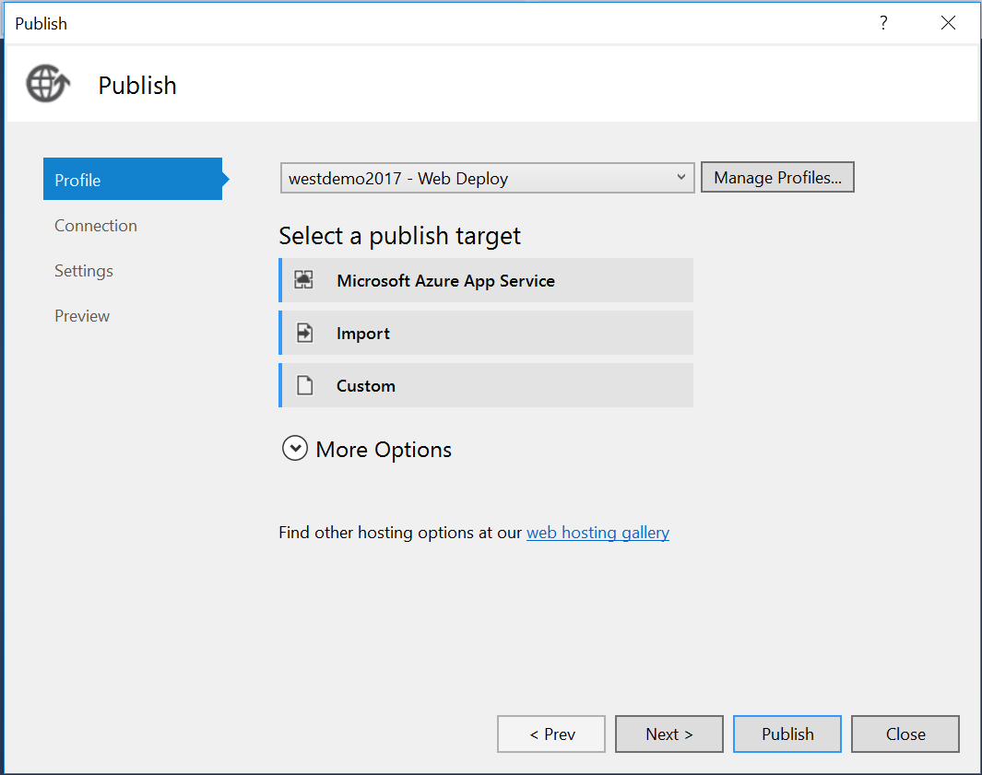
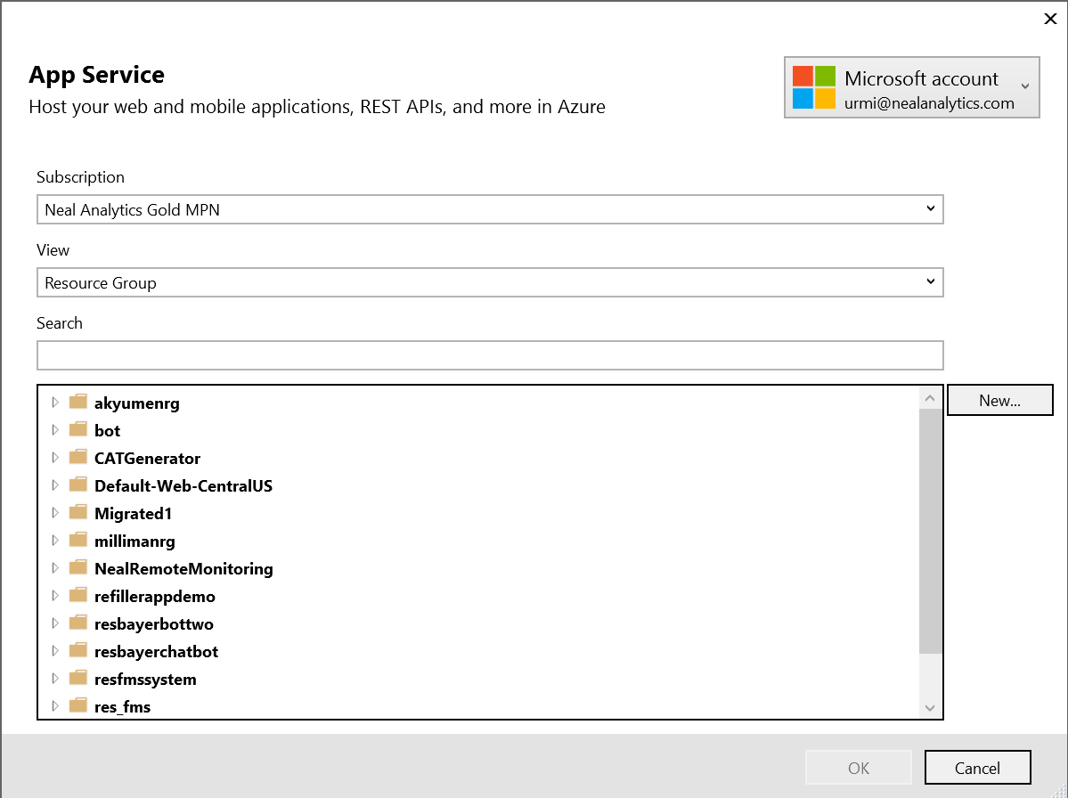
Bot Publication
Web
Click Profile
Click Manage Profiles
Remove any profiles (these are unique to the machine)
Click “Microsoft Azure App Service”
Select an account and Sign in
Select the resource group you just created or selected

Slide 33
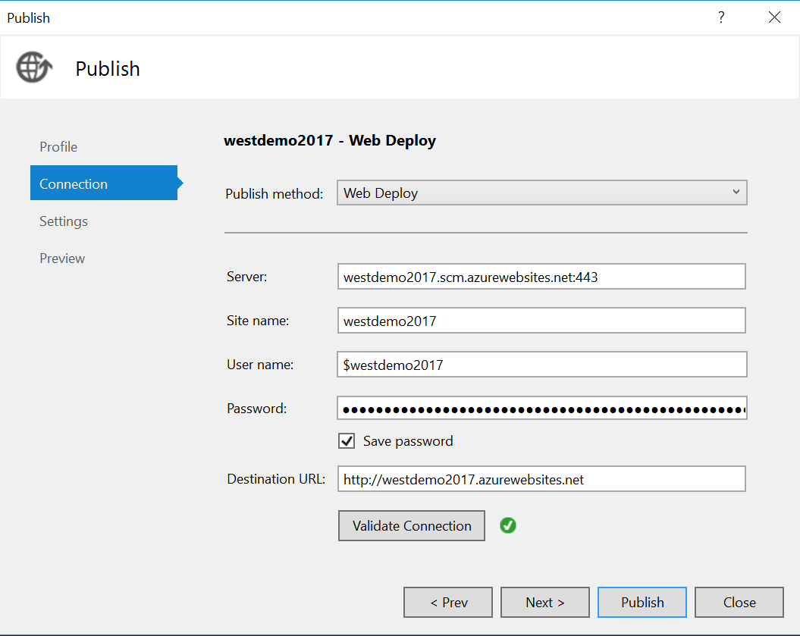
Bot Publication
Web
Click “Validate Connection”
Click “Publish”
Security Feature: You can only publish this app from this machine from now on!!!

Slide 34
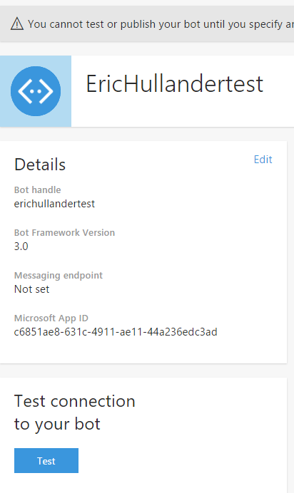
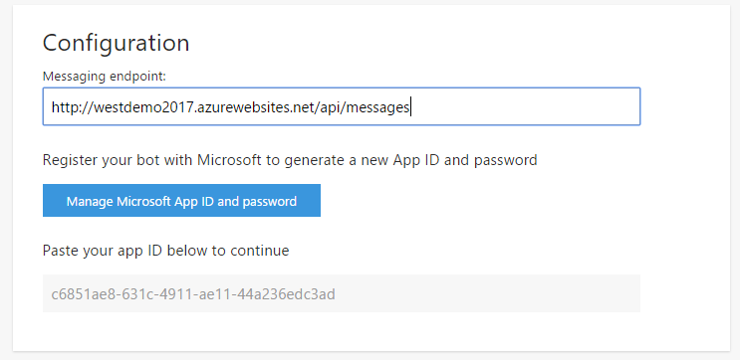
Bot is Live
Click “Validate Connection”
Click “Publish”
Security Feature: You can only publish this app from this machine from now on!!!
Return to https://dev.botframework.com/bots?id=erichullandertest
Click “Edit”
Specify an endpoint

